Slide 1
A Journey Toward Communion
THE MAKING OF THE SAND MANDALA
Mandala photos: Tim Keller Photography

Slide 2
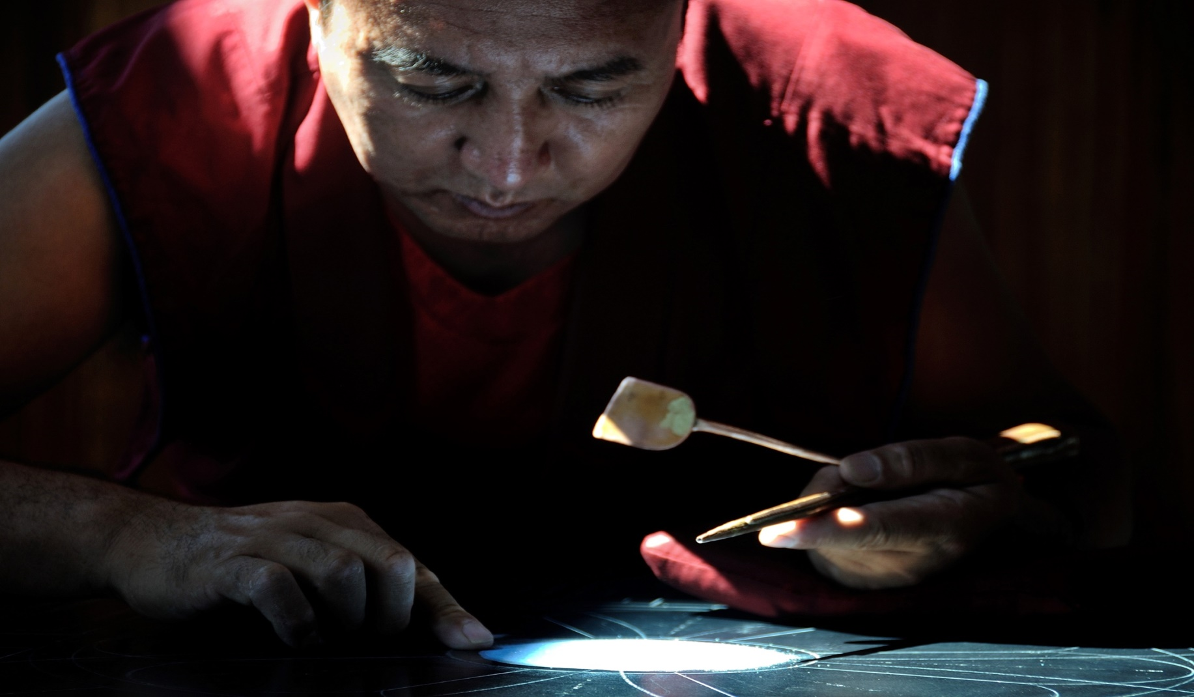
As one seeking to do this work I am but one

Slide 3
One…

Slide 4
but I am not alone

Slide 5
Many are the brushes

Slide 6
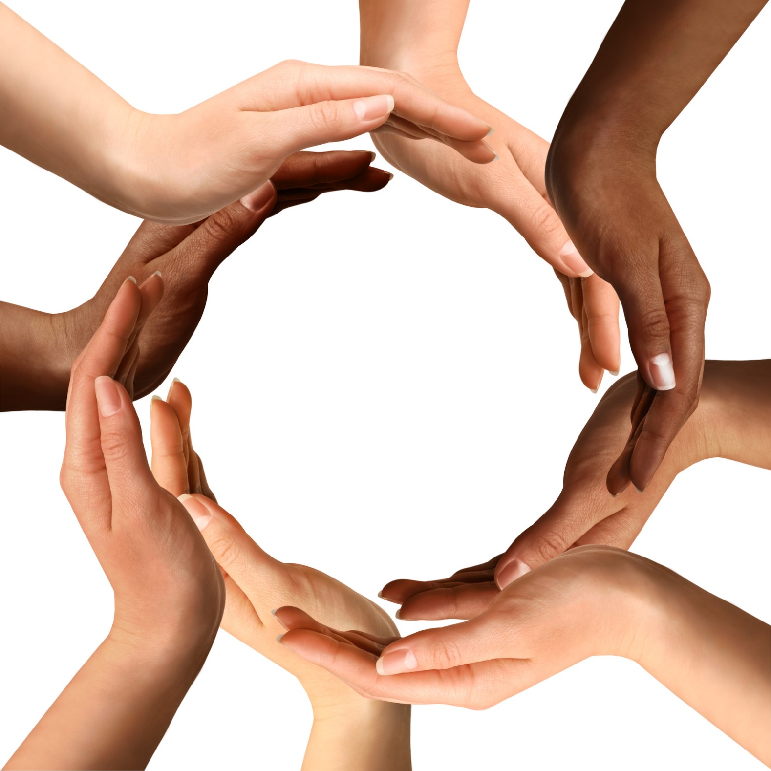
and many the hands

Slide 7
working as one

Slide 8
Many the gifts

Slide 9
put at the service

Slide 10
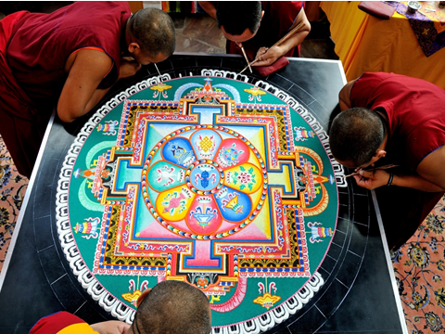
of the whole

Slide 11
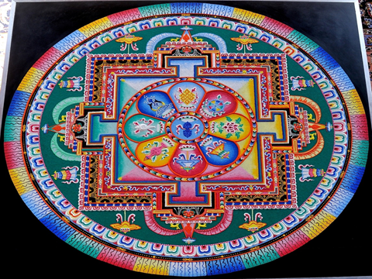

Slide 12
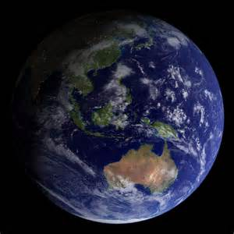

Slide 13
We become One

Slide 14
in the creative energy

Slide 15
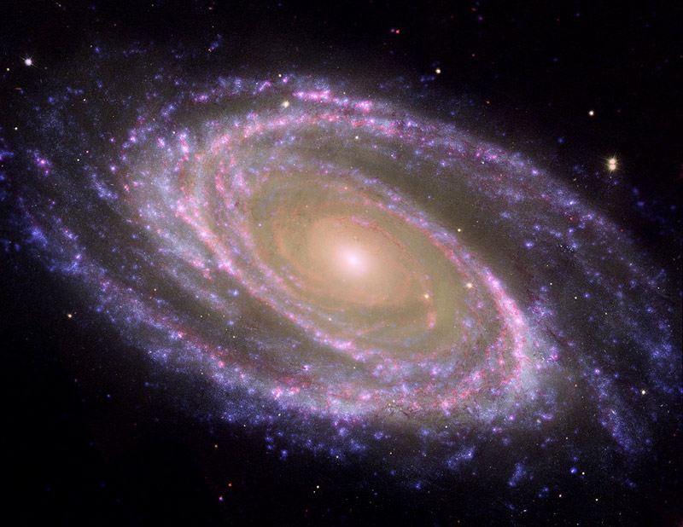
of Love

Slide 16
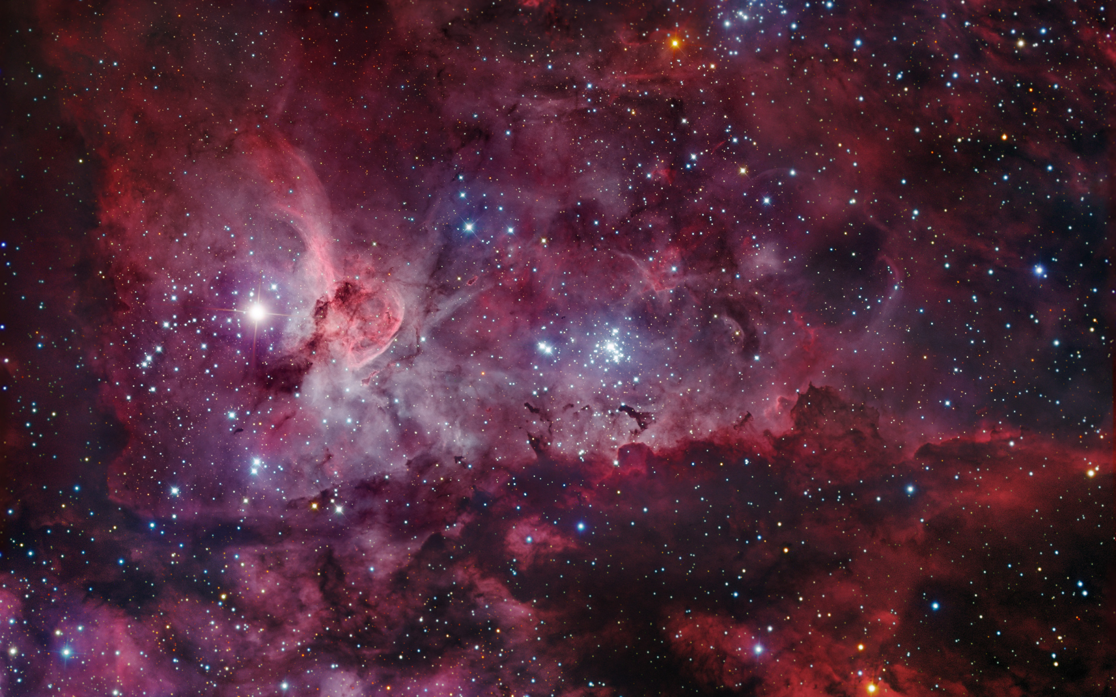
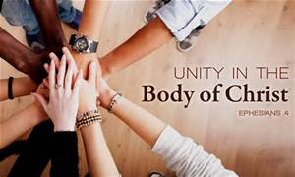
when we walk together in communion

Slide 17
as Christ’s body

Slide 18
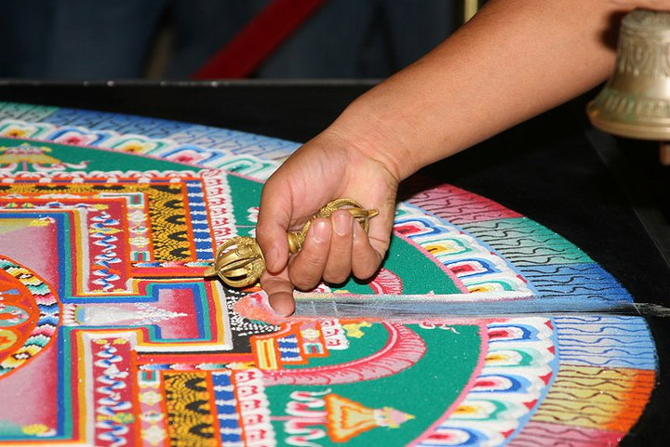
When I can let go of my own corner of the truth

Slide 19
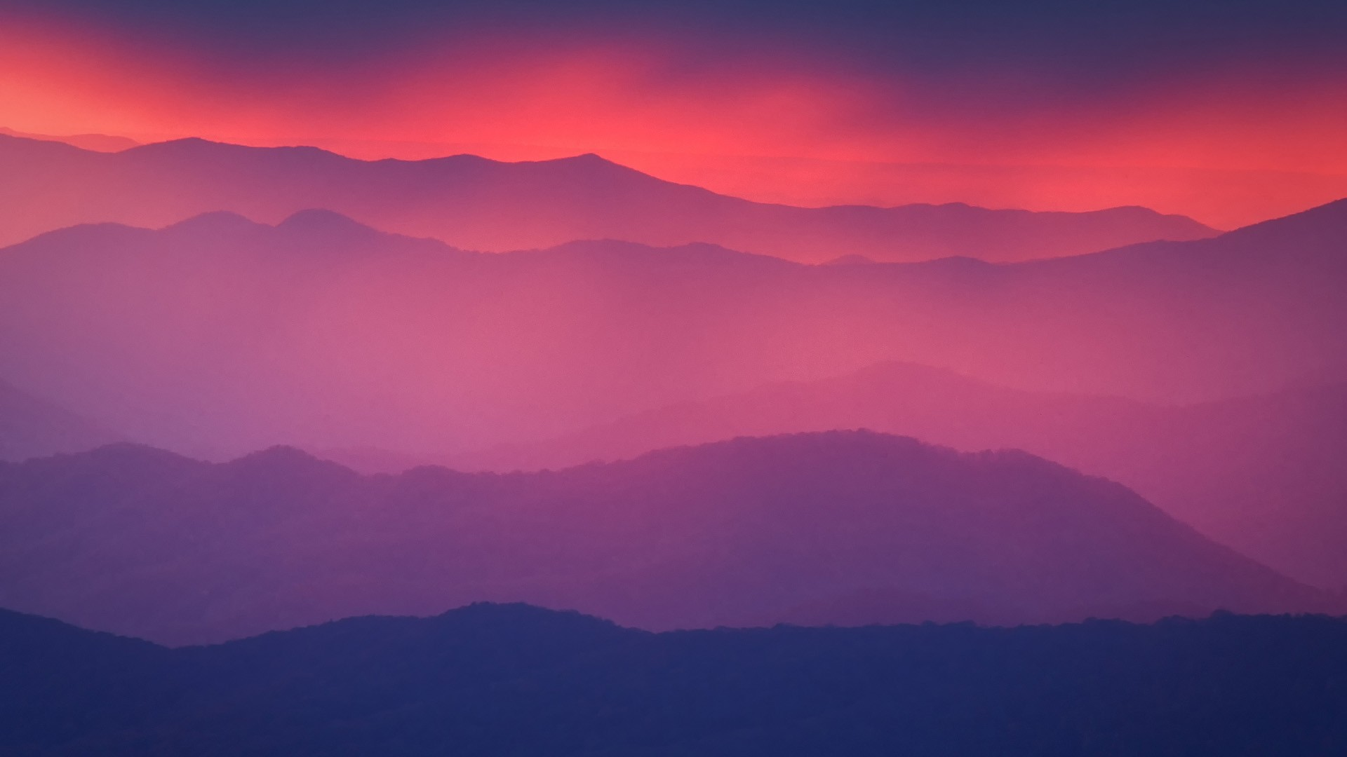
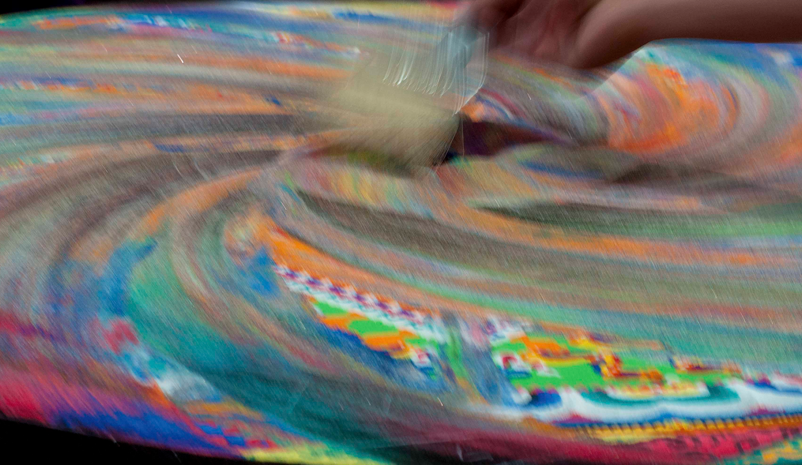
when I can let God be God

Slide 20
Something even more beautiful arises

Slide 21
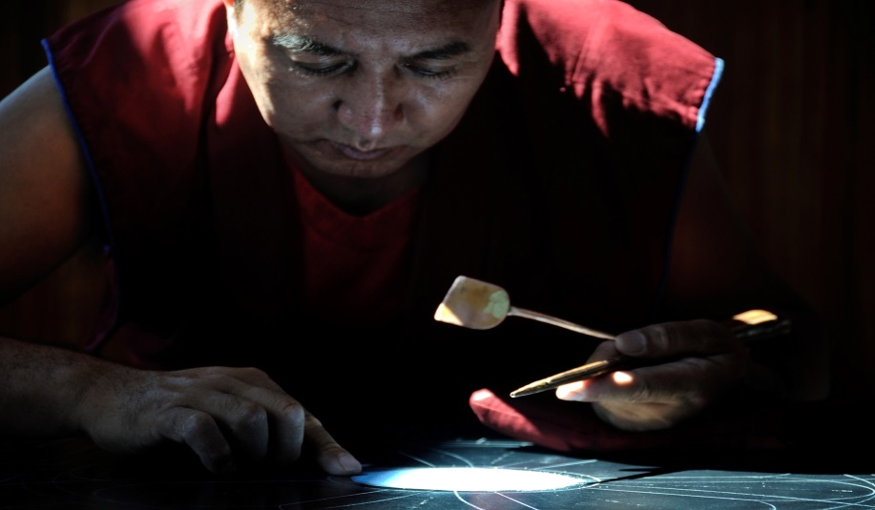
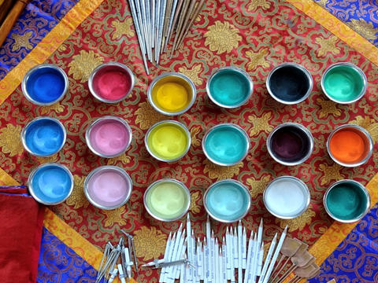
beyond what I first imagined

Slide 22
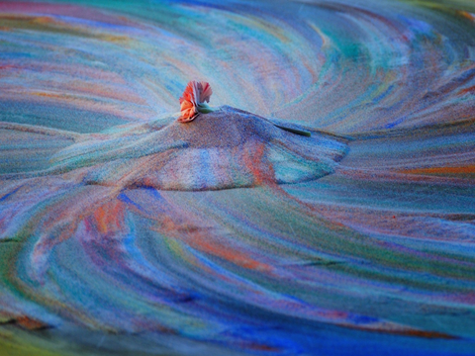
communion

Slide 23
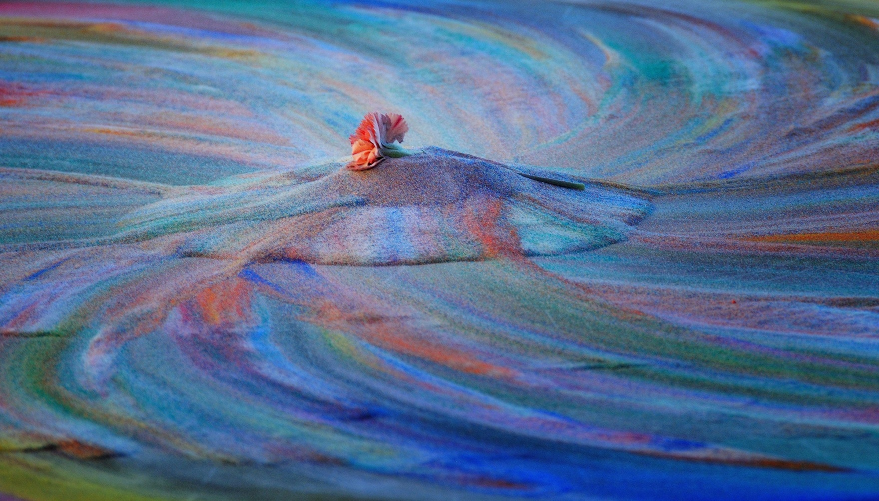
born of Love

