Slide 1
Leadership Team Responsibilities
Designated Coordinator
Handles official communication with:
Generalate, Friars, US Associations & CICLSAL
Leadership contact for:
Grant-writing, Newer Members Gathering,
Prioresses Meeting

Slide 2
Setting our from Avila: a journey toward communion CCA Goal #1
We have fostered a broader acceptance
of unity in diversity
and the mutuality and communion
of the Carmelite family,
especially by continued collaboration
among associations/federations
at home and abroad.

Slide 3
The San Jose STJ500 Celebration was an occasion of collaboration among all the nuns of the USA: Associated and Unassociated

Slide 4
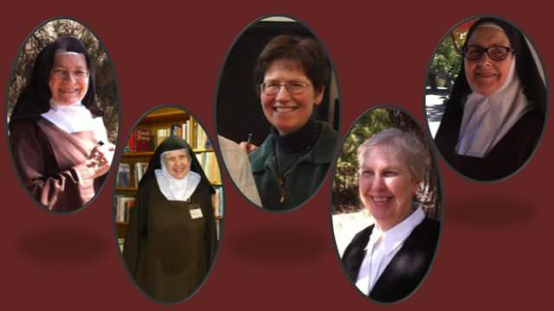
Sisters from the Associations of St. Teresa, Mary, Queen of Carmel and CCA collaborated in creating a beautiful PowerPoint

Slide 5
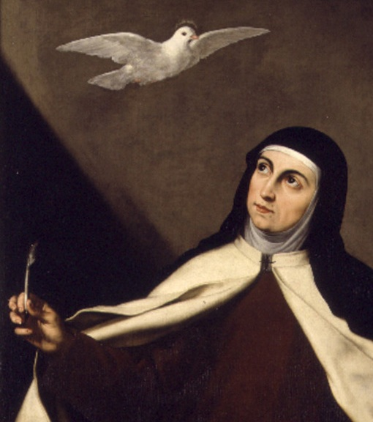
Who are the Sisters of St. Teresa Today?

Slide 6
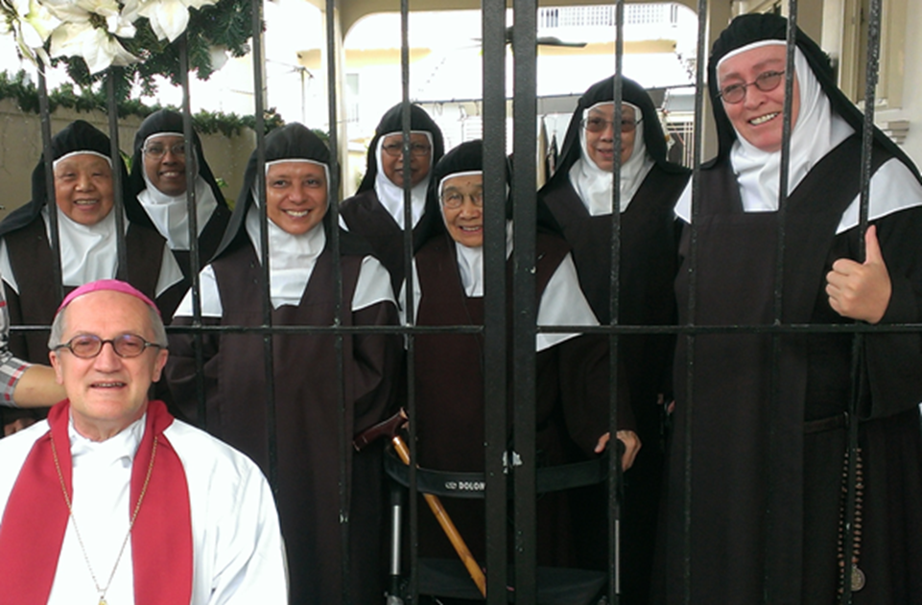
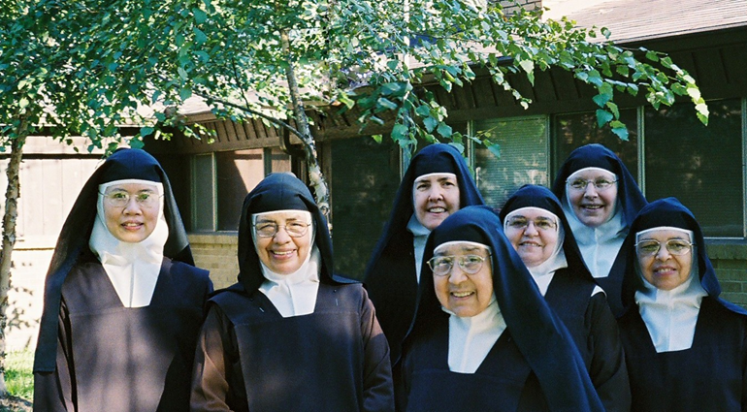
Sisters from most of our US monasteries contributed photos

Slide 7
“We have fostered a broader acceptance of unity in diversity and the mutuality and communion of the Carmelite family, especially by continued collaboration among associations/federations at home and abroad. “ The PowerPoint explored our common Carmelite heritage

Slide 8
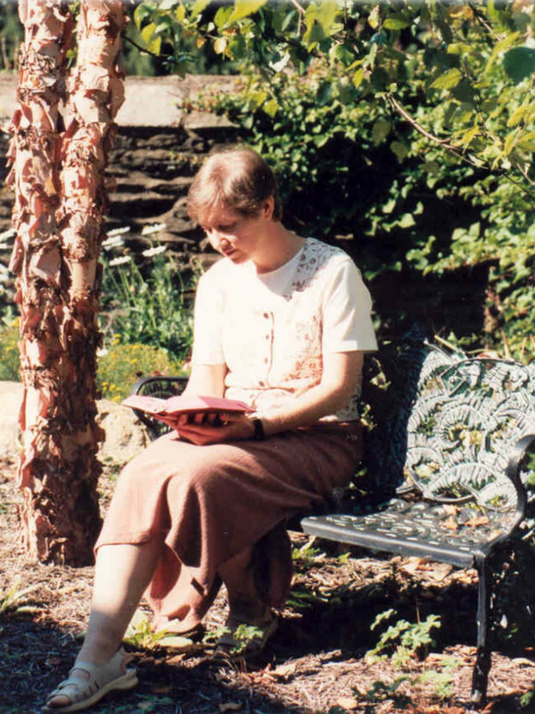
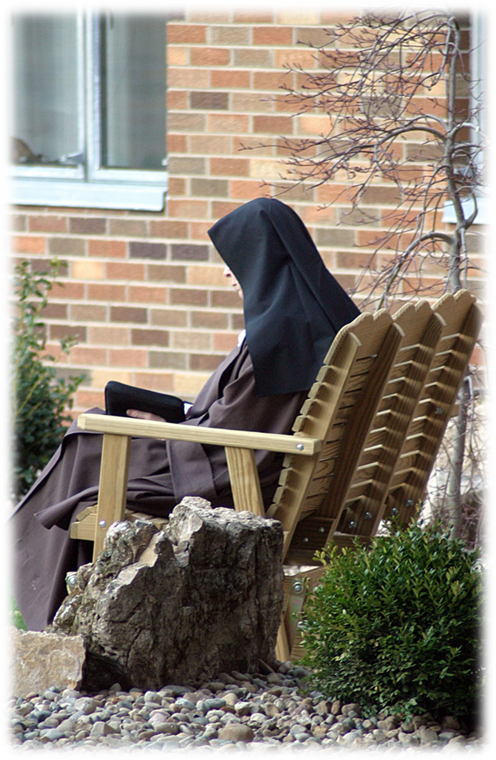
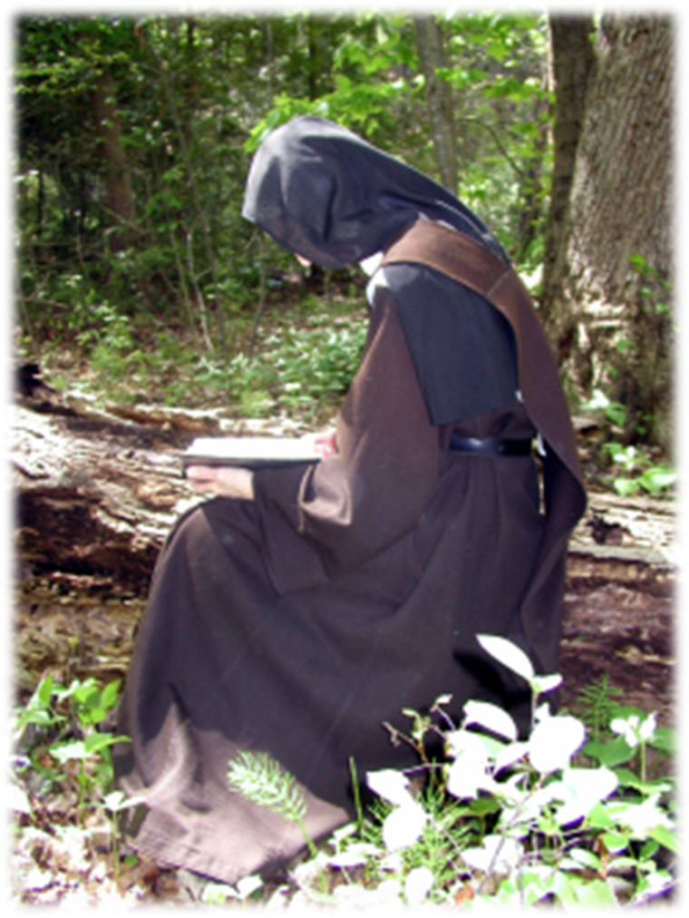
Our Unity
In the Diversity…

Slide 9
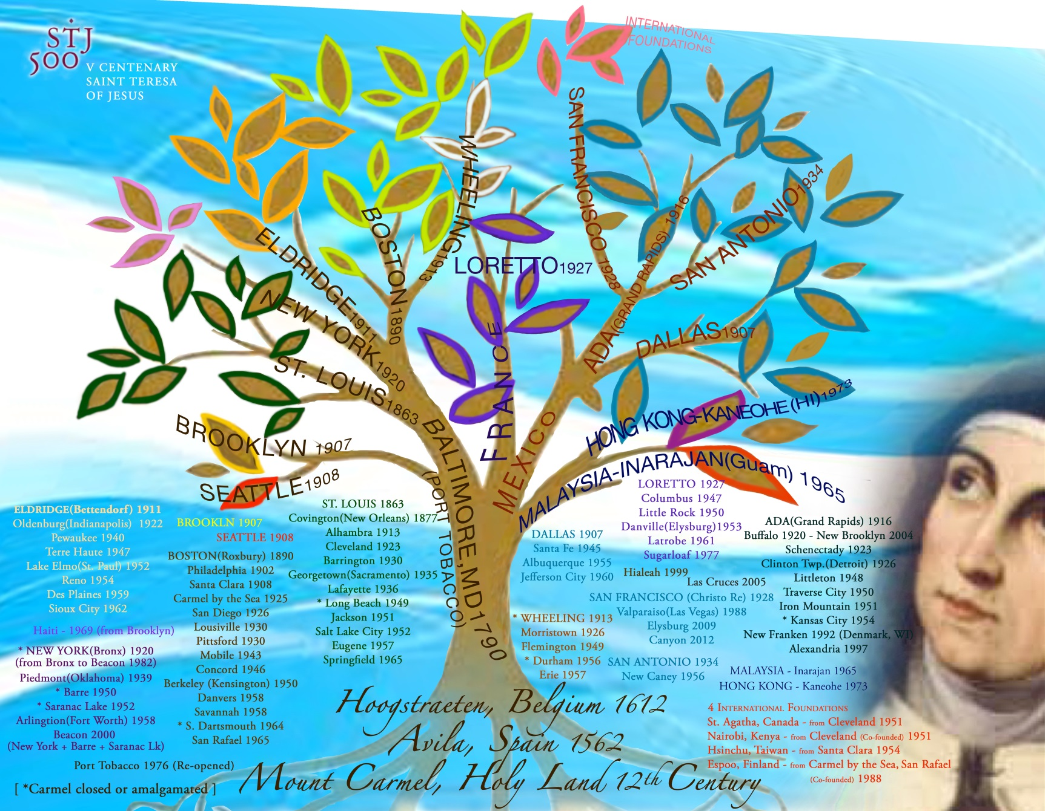
…of the Carmelite family in the USA
PAST
and
PRESENT
Sr. Cecelia Kang, OCD

Slide 10
Gathered from the ends of the earth…
we sang as one voice…

Slide 11
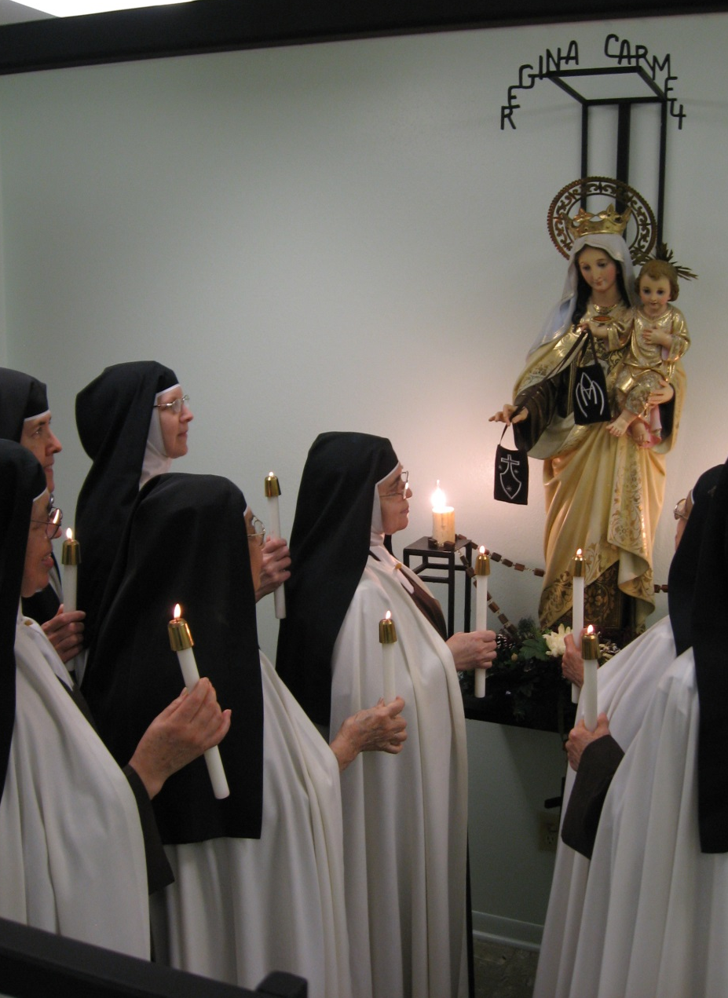
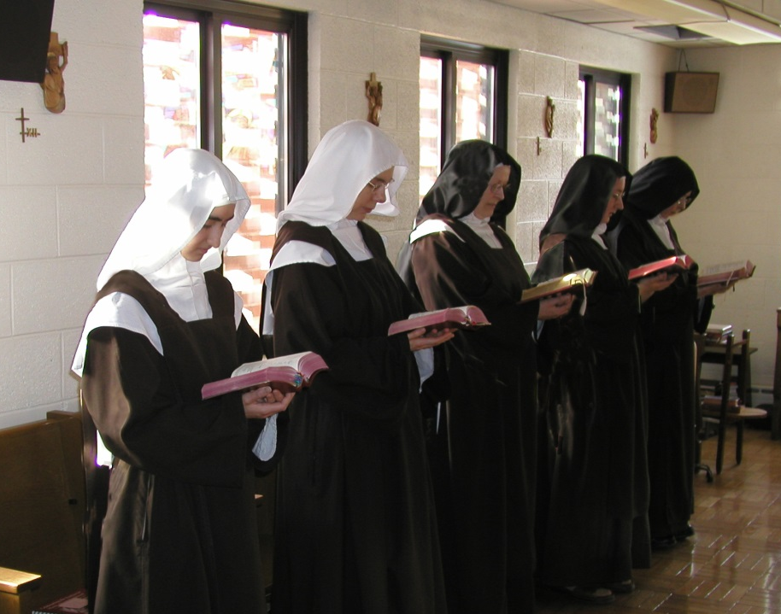
Celebrating together
our unity in Christ!

Slide 12
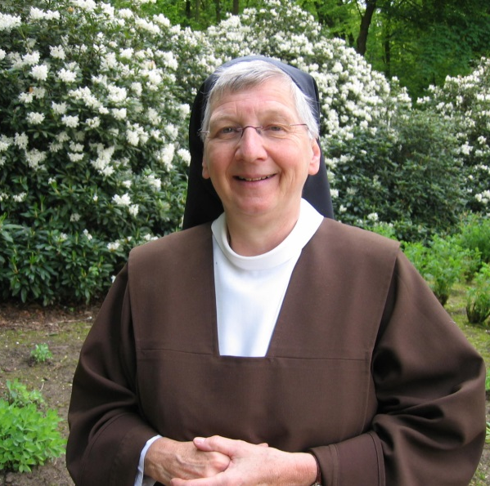
“We have fostered a broader acceptance of unity in diversity and the mutuality and communion of the Carmelite family, especially by continued collaboration among associations/federations at home and abroad. “
in July, 2014 CCA initiated an International Google Hangout
To discuss our responses to the
Roman Questionnaire
Associations represented:
Africa (intended but not successful!)
France
Germany
Holland
Ireland
US - CCA
UK
Stephanie facilitated from Sweden!
Sr. Christine - France
Sr. Claire - USA
Sr. Teresa Benedicta Germany
Sr. Lucia - Holland
Sr. Maire - Ireland
Sr. Allain - UK
Sr. Bendina - Africa
Stephanie - Facilitator

Slide 13
September 2014 CCA accepted an invitation to attend
the UK Association Meeting
“We have fostered a broader acceptance of unity in diversity and the mutuality and communion of the Carmelite family, especially by continued collaboration among associations/federations at home and abroad. “

Slide 14
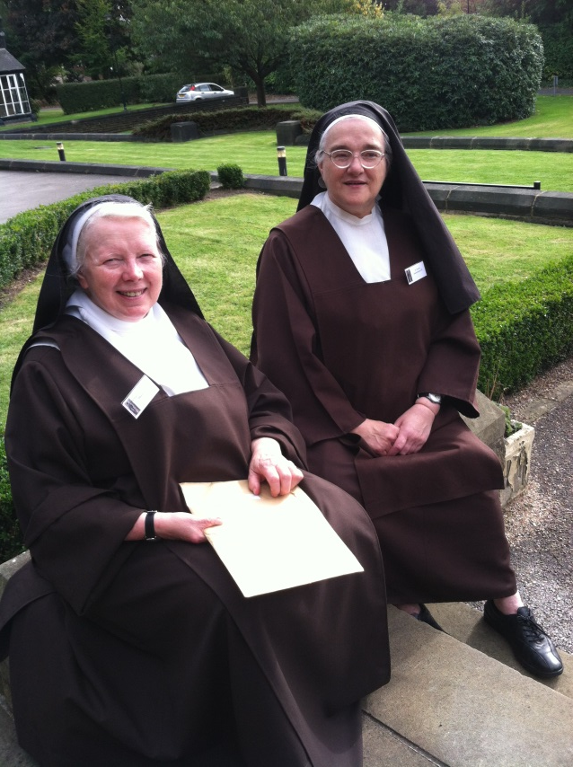

Slide 15
“We have fostered a broader acceptance of unity in diversity and the mutuality and communion of the Carmelite family, especially by continued collaboration among associations/federations at home and abroad.”
UK Association Meeting
October, 2014
Letter to Fr. General

Slide 16
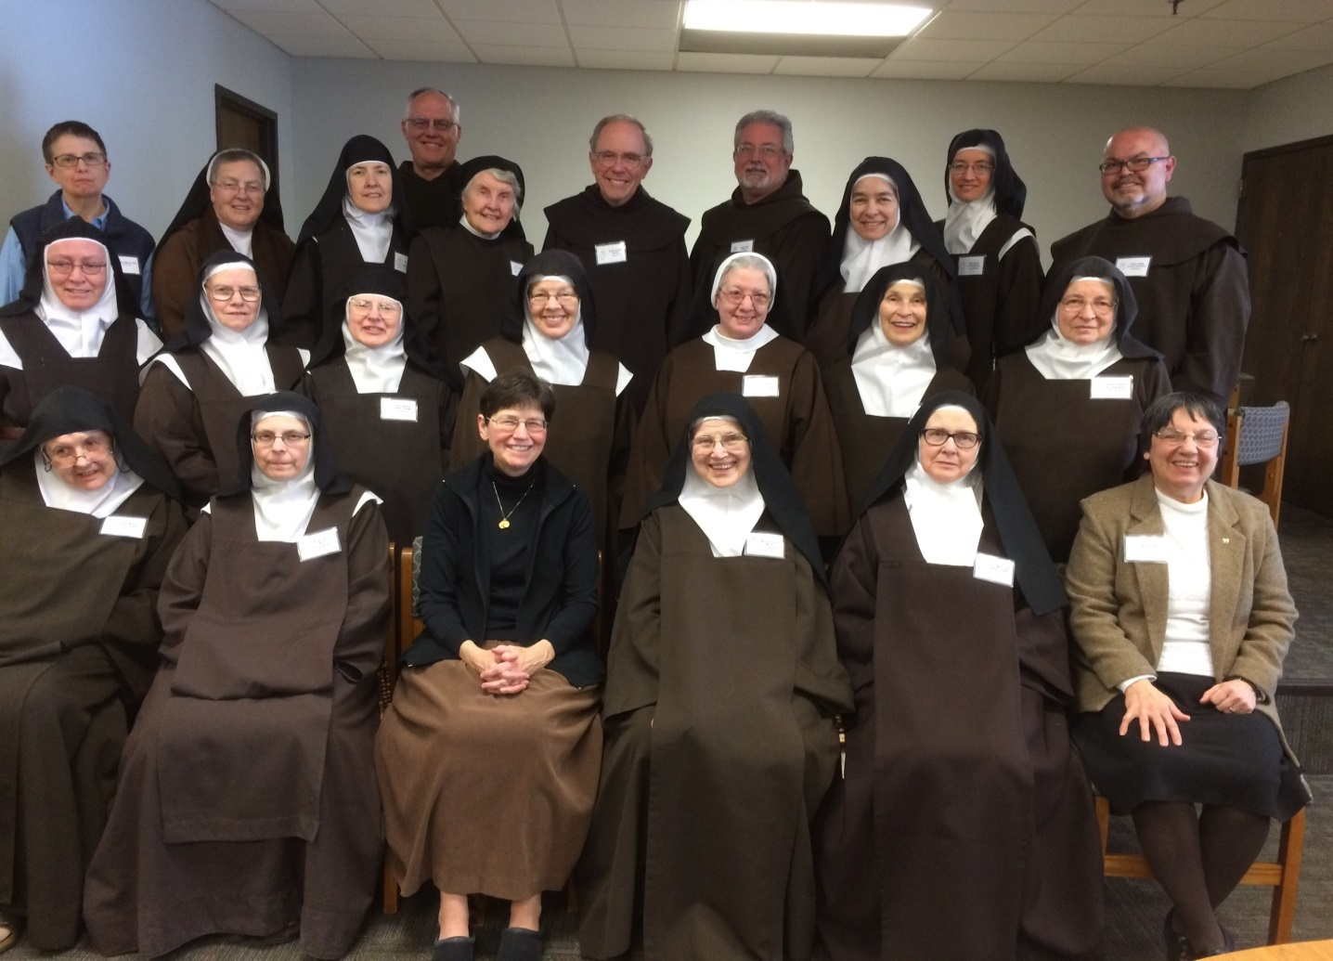
“We have fostered a broader acceptance of unity in diversity and the mutuality and communion of the Carmelite family, especially by continued collaboration among associations/federations at home and abroad. “
General Chapter
Preparation
Meeting of the 4 US Associations
And US Provincials
in Darien, IL
March 1 – 5, 2015
Stephanie facilitated

Slide 17
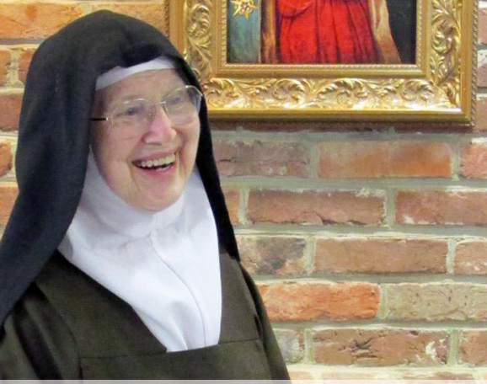
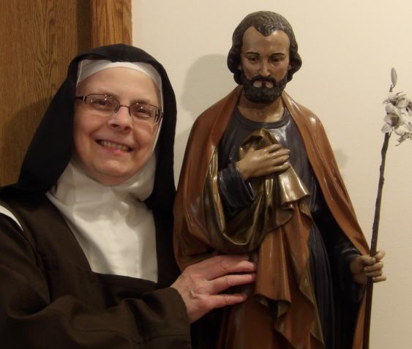
“We have fostered a broader acceptance of unity in diversity and the mutuality and communion of the Carmelite family, especially by continued collaboration among associations/federations at home and abroad. “
Mary, Queen of Carmel
Carmelite Communities Associated
St. Joseph Association
St. Teresa Association
Sr. Mary Clare Trolley
Q of C
Sr. Claire Sokol
CCA
Mother Virginia Marie O’Connor
STA
Mother Therese Marie Crean
SJA

Slide 18
“With determined determination we collaborated on this report and all four Association Councils have approved it as a fair representation of their views.” …General Chapter Report - USA
General Chapter Report – USA
Introduction & Theme One
All the sisters of the English-speaking region in the United States and Canada send sisterly greetings and the assurance of their prayers for the deliberations of the General Chapter. We wish to express our heartfelt thanks to Fr. Saverio, and to Fr. Rafal in particular for the past 6 years of outstanding service to the Nuns, including the opportunity to be represented at the General Chapter, and we wish to congratulate Fr. Saverio on the occasion of his re-election as General for the next 6 years and assure him of our prayers.
Process of choosing the English-speaking representatives
My report represents 4 Associations in the USA. (See statistics on a separate handout.) The decision to arrive at a representative from the United States was difficult because our Associations are divided along ideological lines. However, with determined determination we collaborated on this report and all four Association councils have approved it as a fair representation of their views.

Slide 19
On the occasion of the 500th birthday of Saint Teresa we joined in prayer for world peace at the urging of Fr. General and in solidarity with Pope Francis
“We have fostered a broader acceptance of unity in diversity
and the mutuality and communion
of the Carmelite family, especially by continued collaboration among associations/federations at home and abroad. “

Slide 20
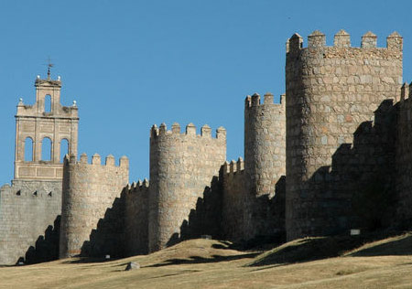
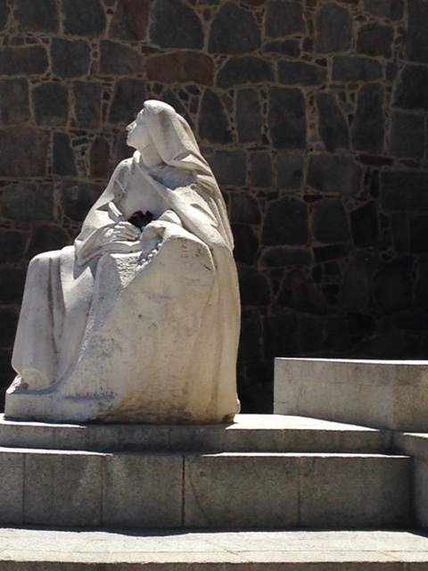
“We have fostered a broader acceptance of unity in diversity and the mutuality and communion of the Carmelite family, especially by continued collaboration among associations/federations at home and abroad. “
General Chapter
Avila, Spain
May, 2015

Slide 21
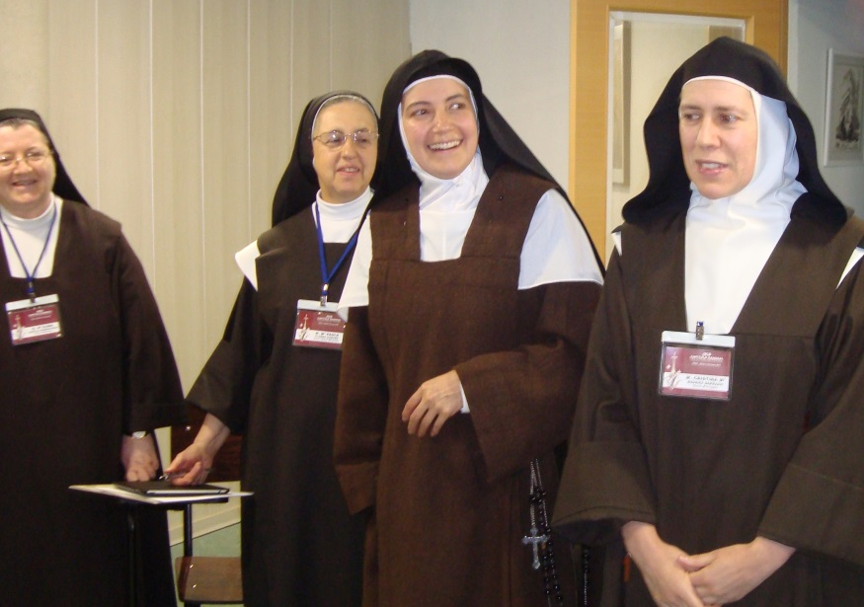
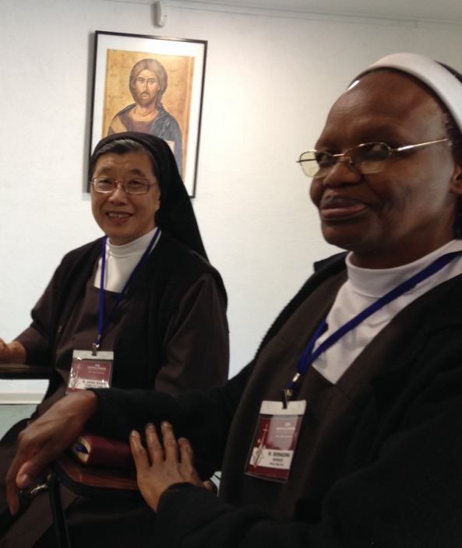
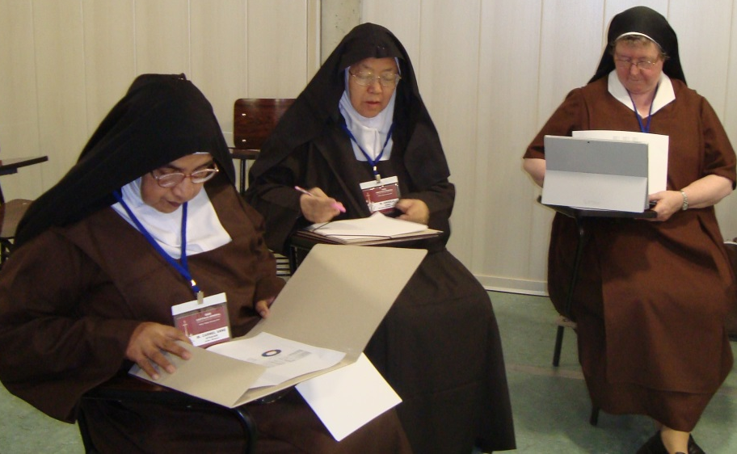
“We have fostered a broader acceptance of unity in diversity and the mutuality and communion of the Carmelite family, especially by continued collaboration among associations/federations at home and abroad. “
The Sisters gather
with Fr. Rafal
to begin our sharing
General Chapter

Slide 22
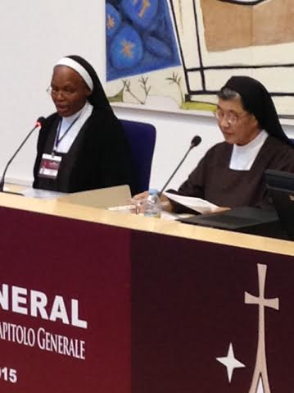
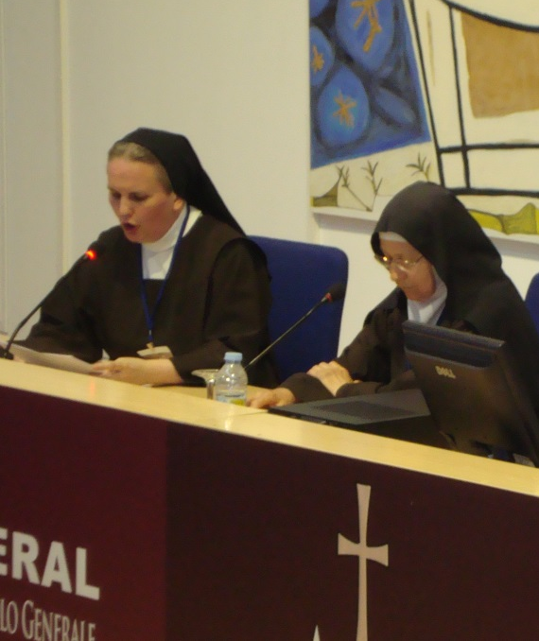
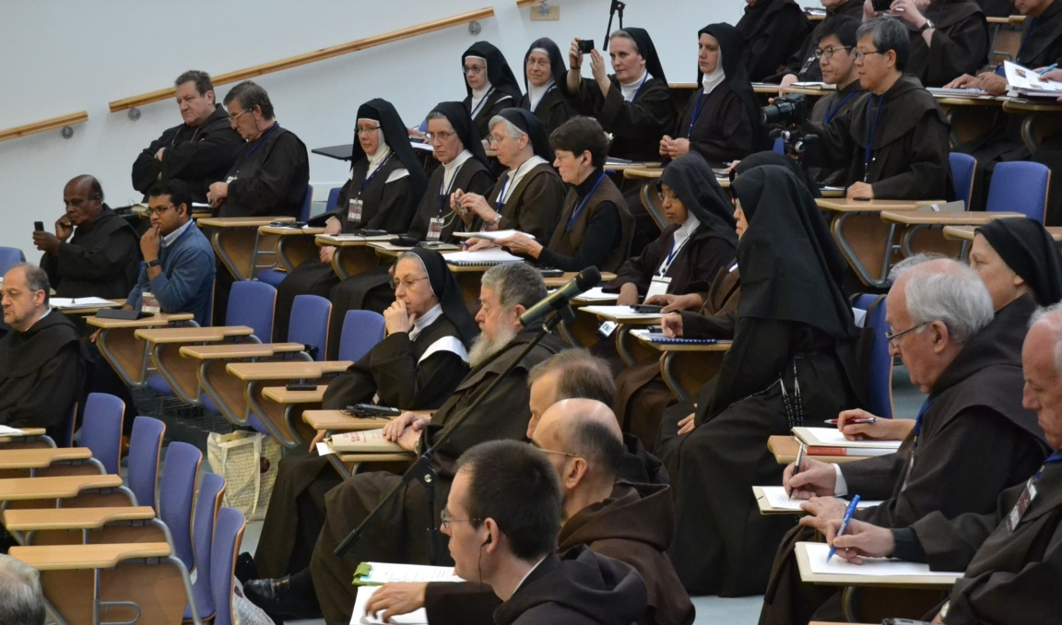
General Chapter Reports

Slide 23
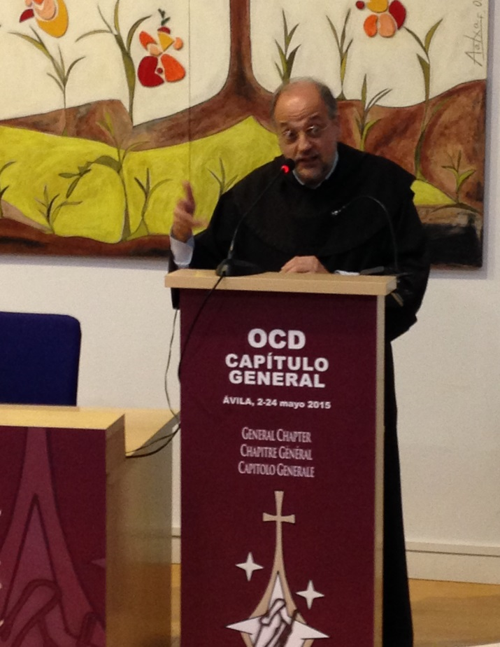
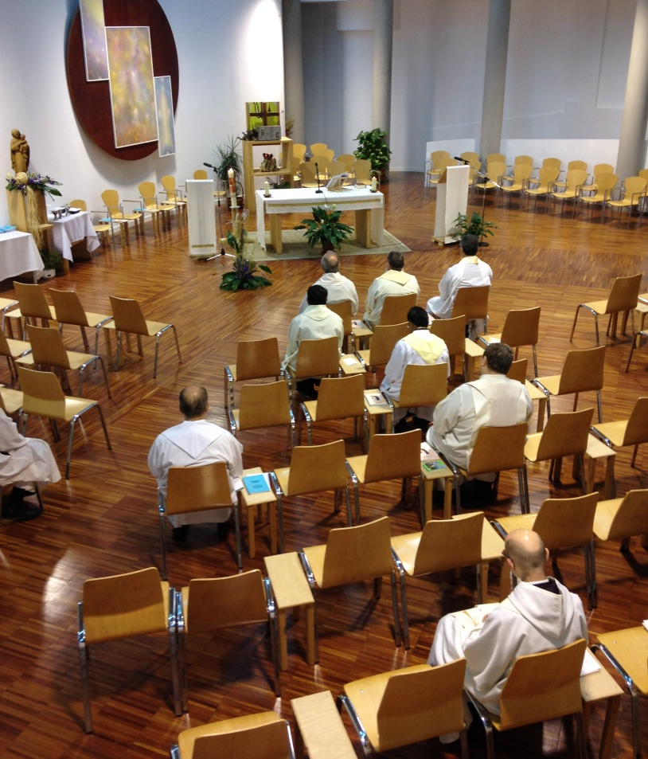
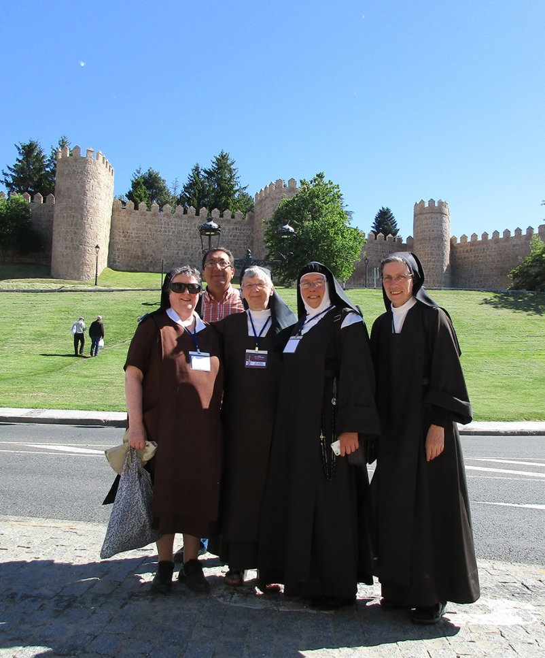
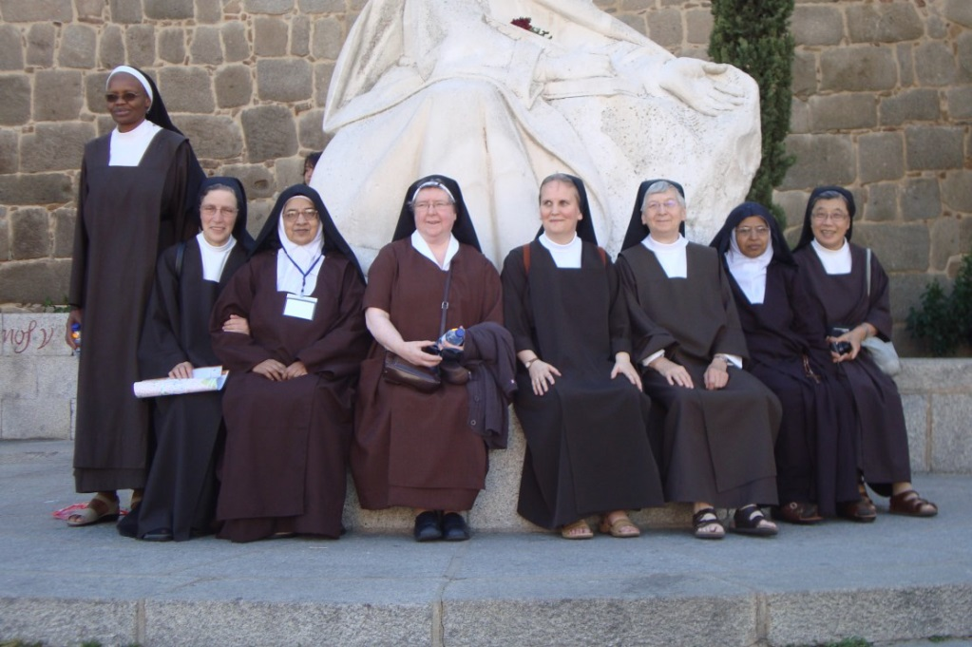
We worked… and we prayed… and we played

Slide 24
…and Sr. Claire presented an offering to Fr. General on behalf of the 4 Associations of the USA
“We have fostered a broader acceptance of unity in diversity
and the mutuality and communion
of the Carmelite family, especially by continued collaboration among associations/federations at home and abroad. “

Slide 25
We stayed connected…

Slide 26
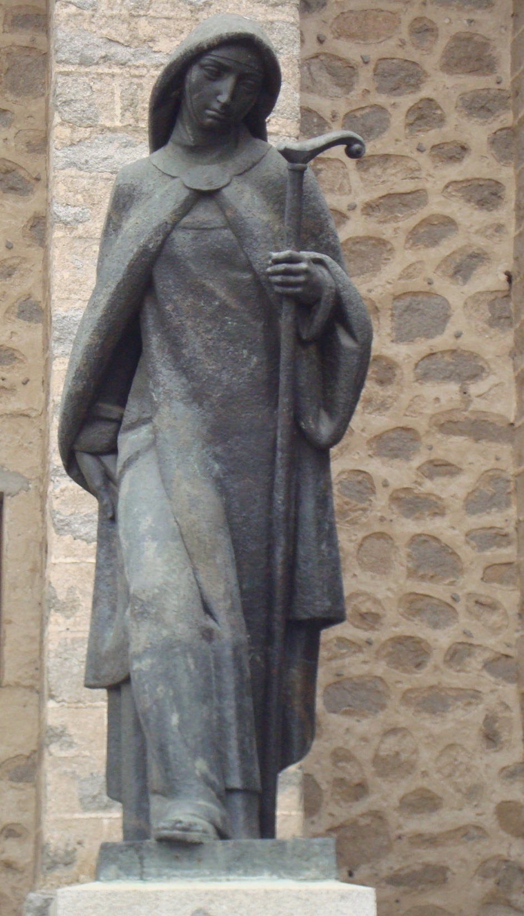
Autonomy well lived opens to relationships. The autonomy poorly lived turns into infantile enclosure and isolation.
…only the monastery which knows how to manage its own autonomy is not afraid to enter into relationships with others.
Communion among the Nuns Fr. Rafal Wilkowski

Slide 27
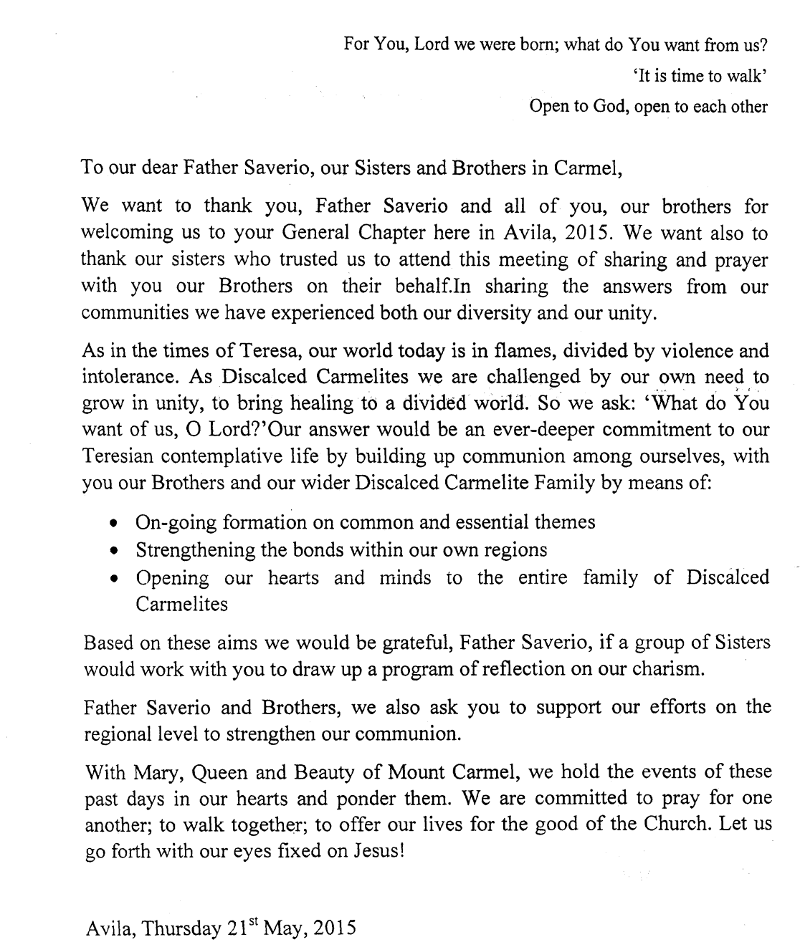
“True, relationship with others… means to create family ties, to share ideas, to work together…” Communion among the Nuns Fr. Rafal Wilkowski
Message of the Discalced Carmelite Sisters
to the Order

Slide 28
“We are challenged by our own need to grow in unity, to bring healing to a divided world. So we ask: ‘What do You want of us, O Lord?’ Our answer would be an ever-deeper commitment to our Teresian contemplative life by building up communion among ourselves…” Message of the Discalced Carmelite Sisters to the Order
“We have fostered a broader acceptance of unity in diversity and the mutuality and communion of the Carmelite family, especially by continued collaboration among associations/federations at home and abroad. “

Slide 29
After Avila, our sharing continued…
General Chapter Report from Holland
General Chapter Report from USA
General Chapter Report from Australia

Slide 30
CCA was pleased to be invited to the Mary, Queen of Carmel Formation Meeting. Two of our sisters were able to attend and thoroughly enjoyed their time.
“We have fostered a broader acceptance of unity in diversity and the mutuality and communion of the Carmelite family, especially by continued collaboration among associations/federations at home and abroad. “

Slide 31
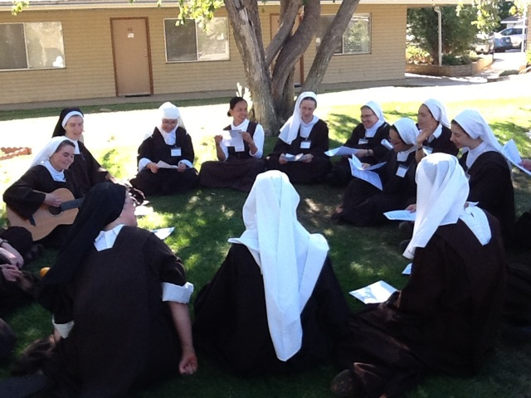
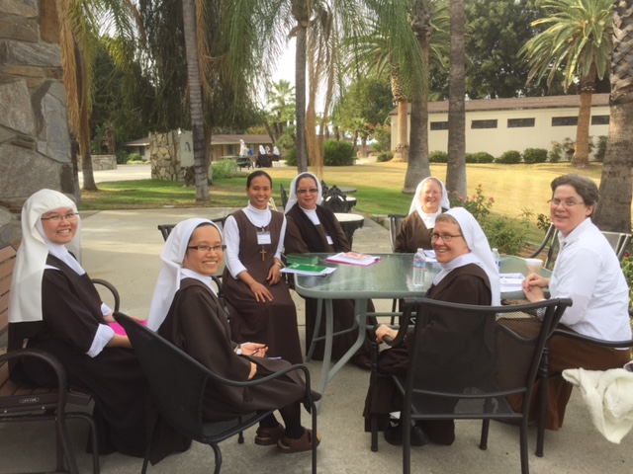
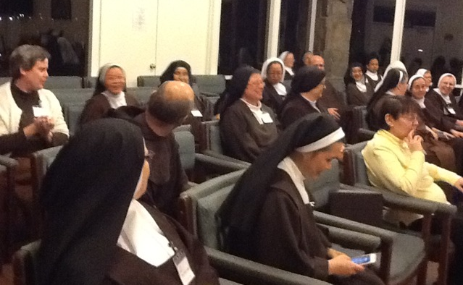
Deepening our lives through sharing, prayer…

Slide 32
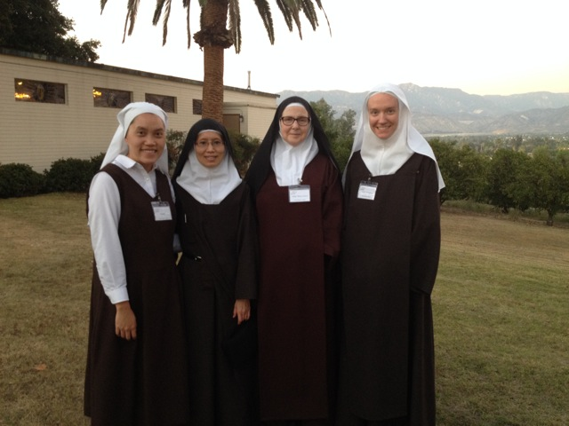
…and the support of friendship.
“We have fostered a broader acceptance of unity in diversity and the mutuality and communion of the Carmelite family, especially by continued collaboration among associations/federations at home and abroad. “

Slide 33
rome
Consecrated Life In Communion

Slide 34
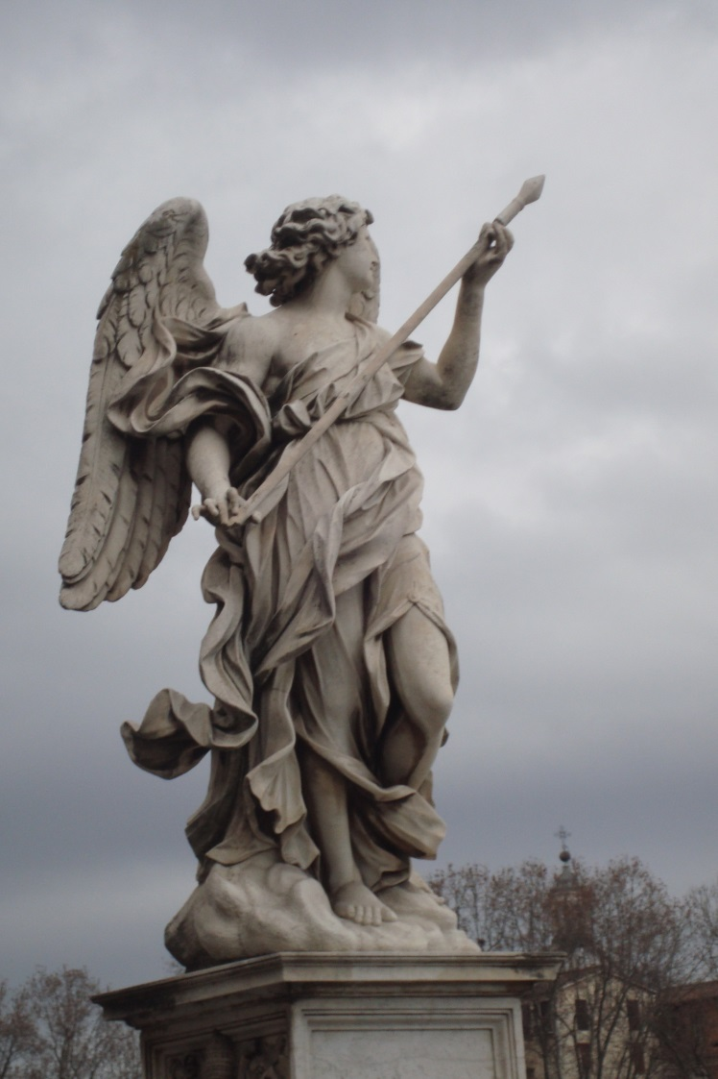
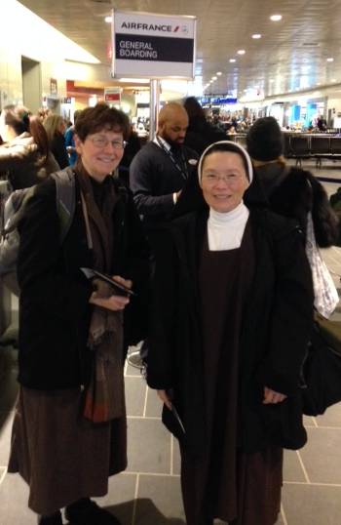
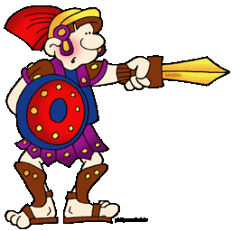
Ready or not – here we come!

Slide 35
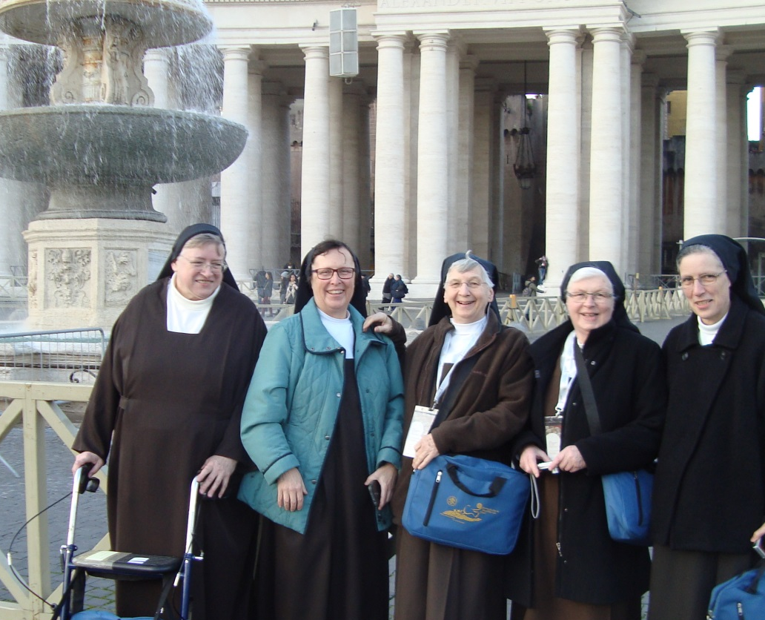
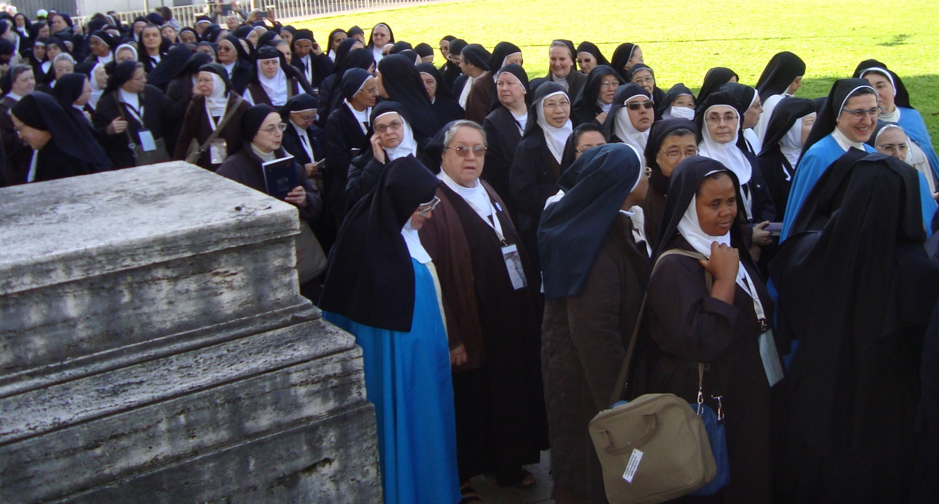
…and we came

Slide 36
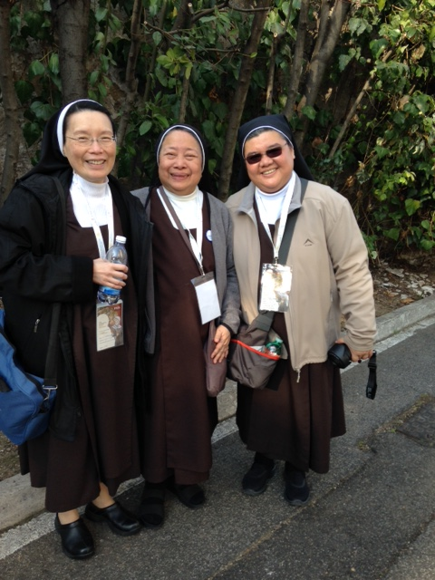
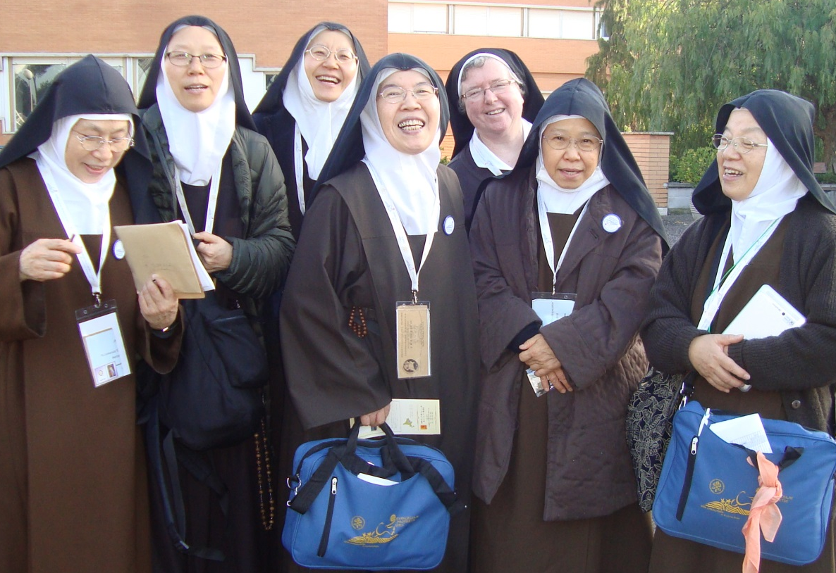
From every nation
on earth
we came…!

Slide 37
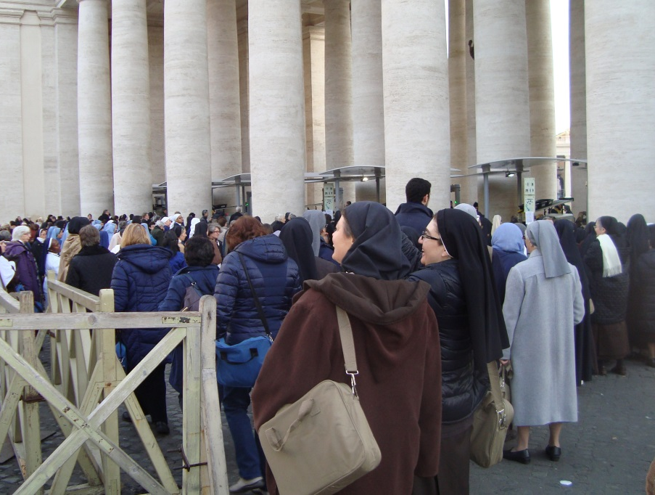
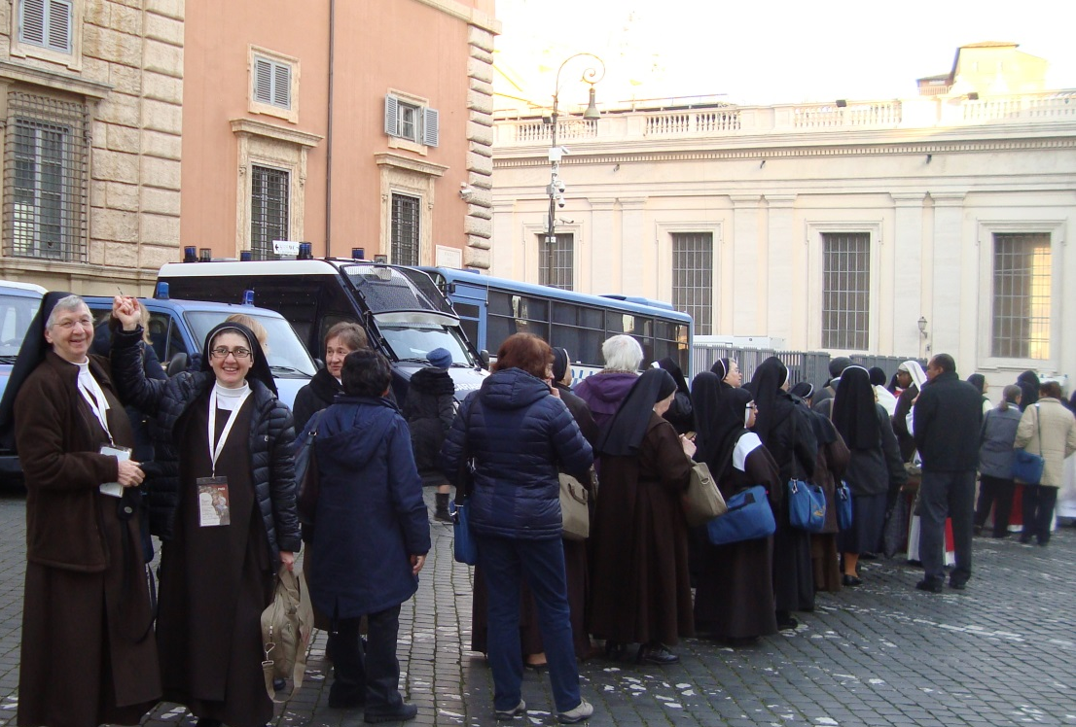
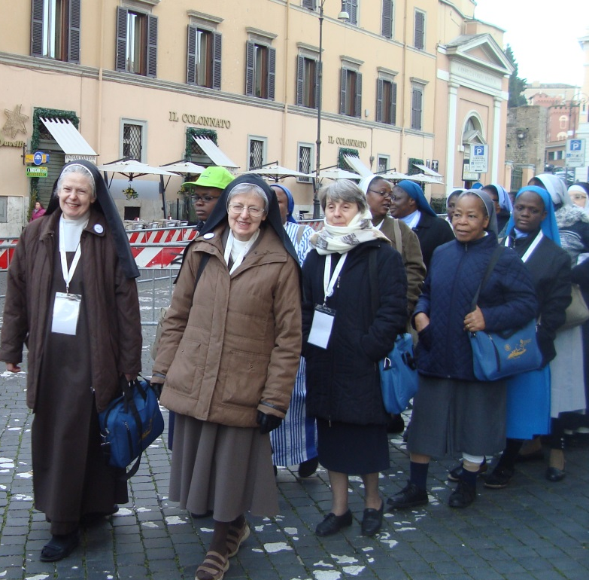
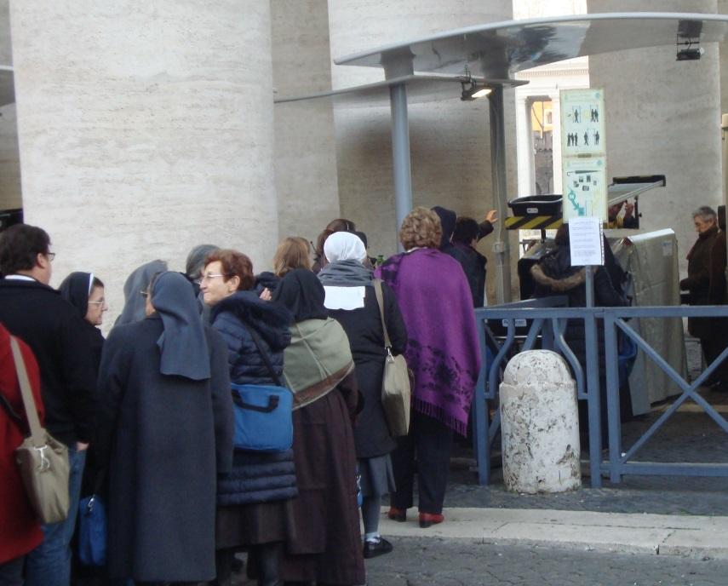
Each morning we braved the security lines

Slide 38
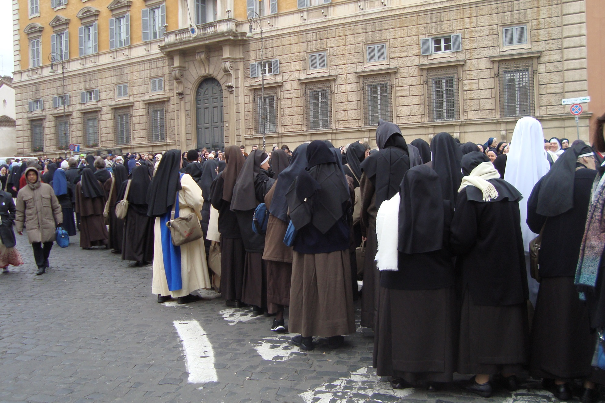
Did I mention the security lines?

Slide 39
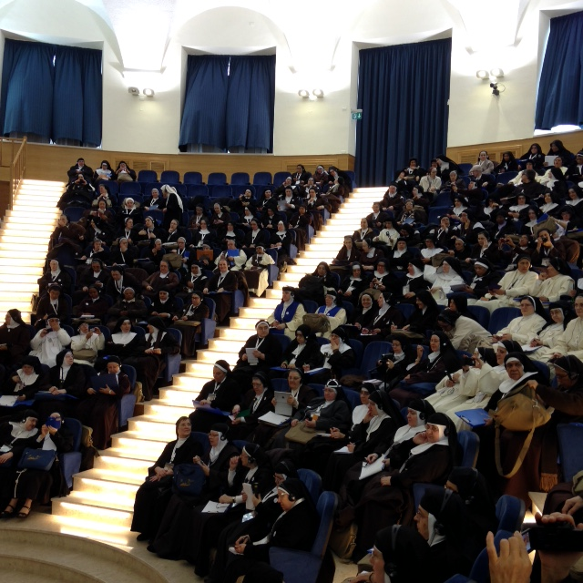
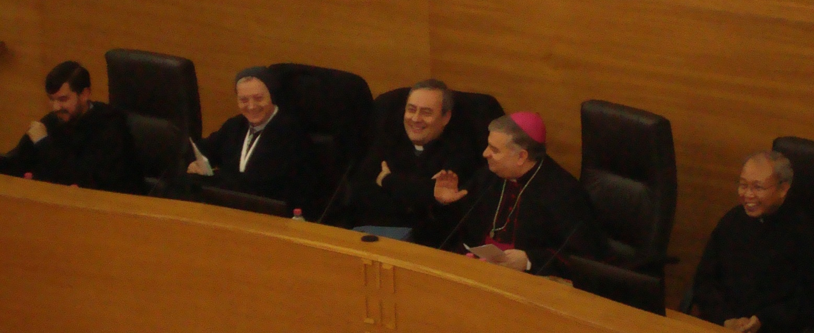
we listened…

Slide 40
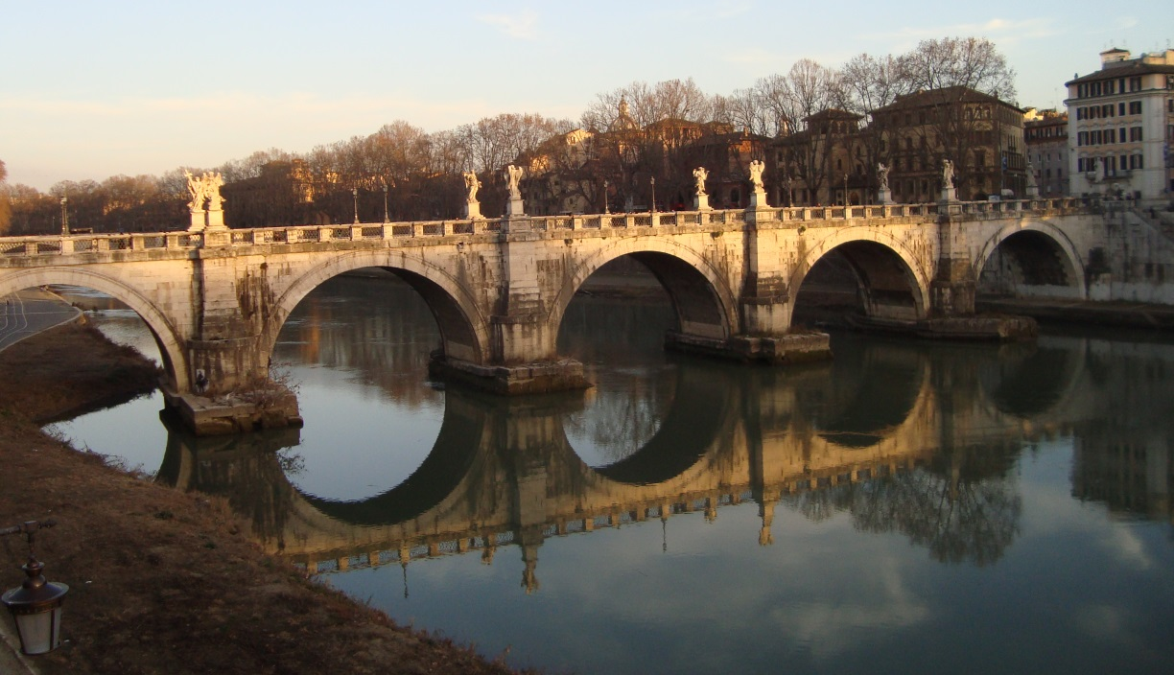
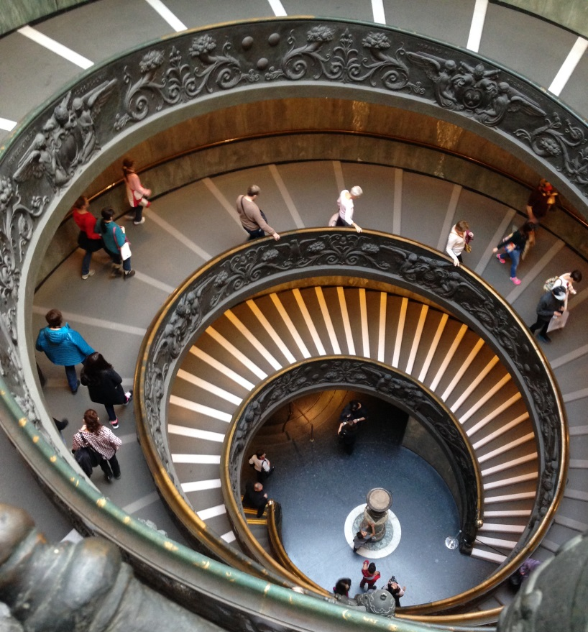
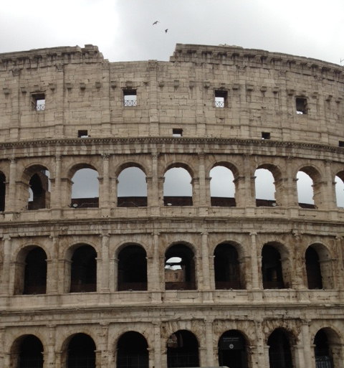
we explored…

Slide 41
we ate!…
we ate!…we ate!…
we ate!…we ate!…
and…

Slide 42
we prayed

Slide 43
And we played…
“We have fostered a broader acceptance of unity in diversity and the mutuality and communion of the Carmelite family, especially by continued collaboration among associations/federations at home and abroad. “

Slide 44
we waited…
And we saw!…

Slide 45
we have come a long way…
“We have fostered a broader acceptance of unity in diversity and the mutuality and communion of the Carmelite family, especially by continued collaboration among associations/federations at home and abroad. “

Slide 46
to arrive at where we are TODAY…
“We have fostered a broader acceptance of unity in diversity and the mutuality and communion of the Carmelite family, especially by continued collaboration among associations/federations at home and abroad. “

Slide 47
For all that has been THANKS For all that will be YES

