Slide 1


CCA & MLC
CCA
On-going Formation
Initiative

Slide 2
How it All began…
July 16, 2012 Letter from Fr. Saverio to the Nuns of the Order
He urges the nuns to “complete the journey of education in autonomy and in responsible participation in the government of our communities” through a solid theoretical and practical formation, noting “a new mentality concerning the role of women in the Church” since Vatican II.
CCA Assembly, 2014 Goal #3
We have developed and empowered our members to be future
leaders and/or contributors of CCA.

Slide 3
How it All began…
General Chapter Avila, 2015
After listening to all the reports of the Nuns, Fr. General affirmed on- going formation as the most critical need for the nuns during the next 6 years.
Conversations with the Nuns at the Chapter…

Slide 4

How it All began…
The flame was lit!

Slide 5

How it All began…
The Conversations Began…

Slide 6
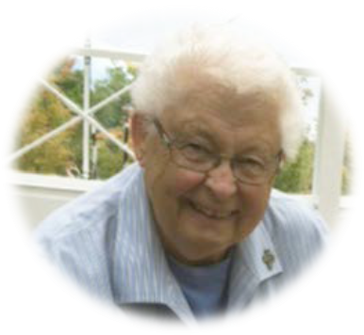

And a pathway opened up leading to …

Slide 7
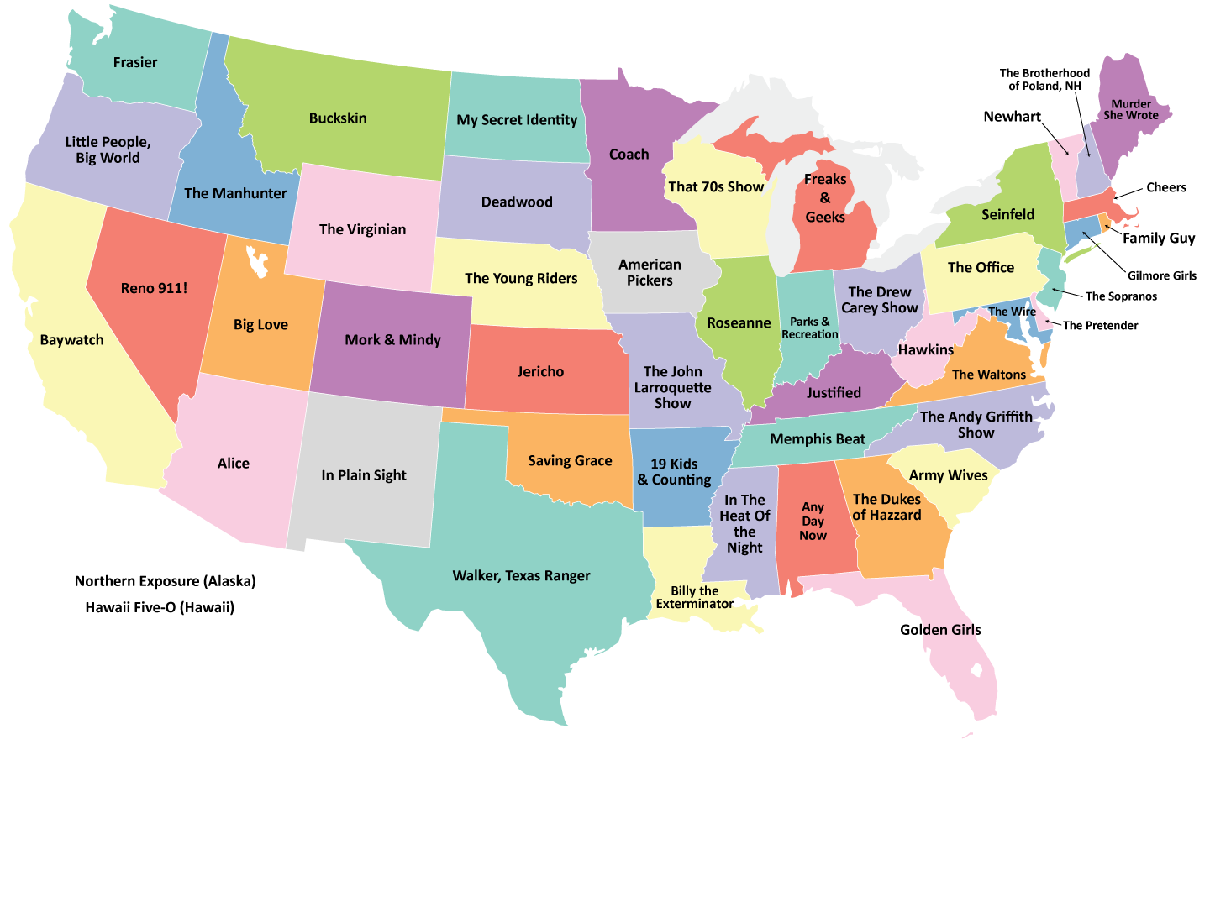
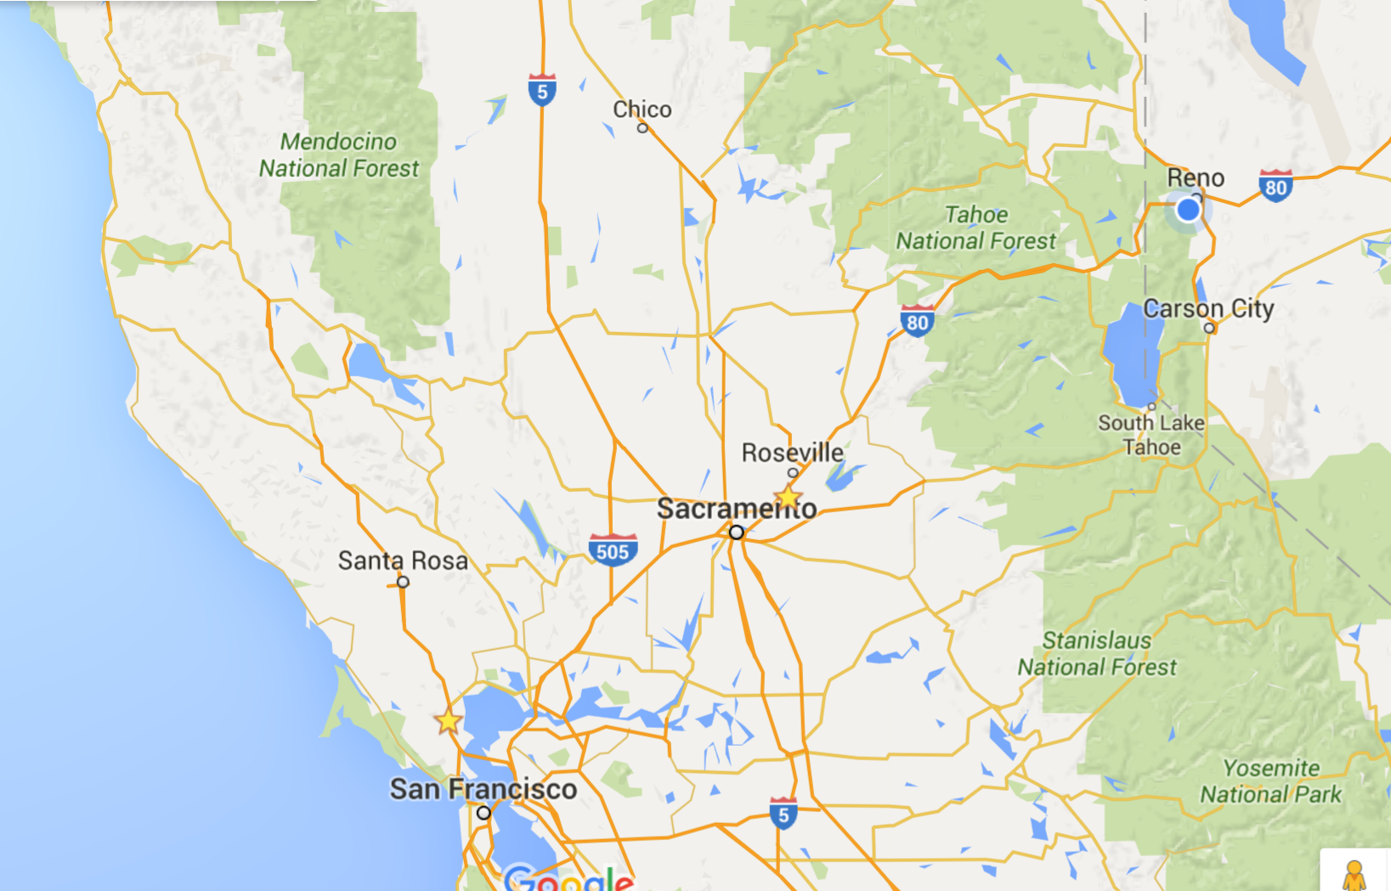
Sacramento and…

Slide 8
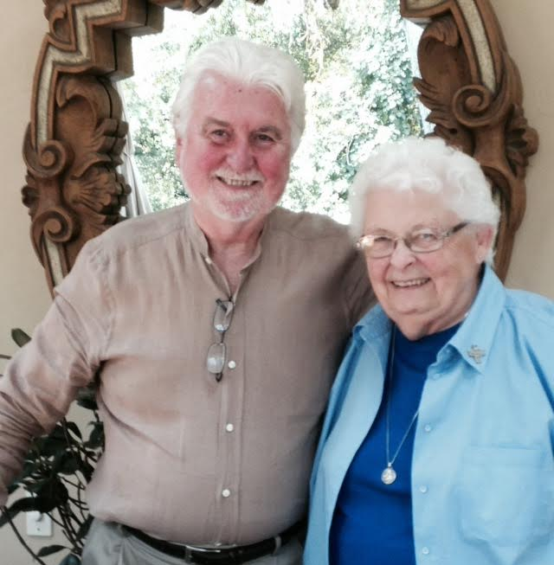
Dr. Larry O’Connell
Sr. Kathleen Pruitt, CSJP
The Ministry Leadership Center
Sacramento, August 2015

Slide 9
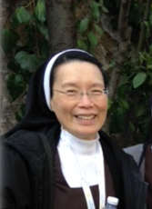
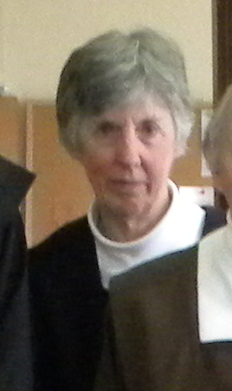
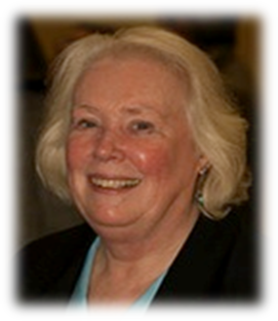
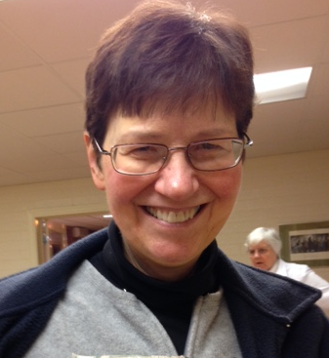
CCA Visioning Committee

Slide 10
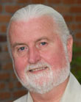

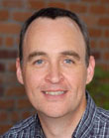
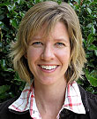
MLC Staff
Larry O’Connell, President / CEO
Elizabeth McCabe, Executive Director, Formation &
Integration Initiatives
Diarmuid Rooney, Executive Director, Formation &
Communication Technology
Kathryn Racine, Special Assistant
to the President

Slide 11
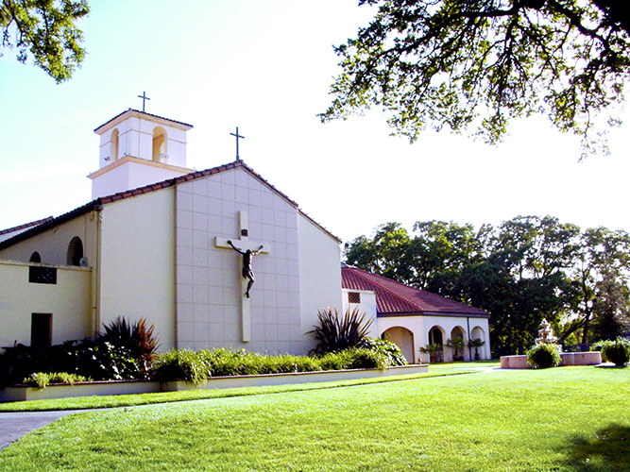
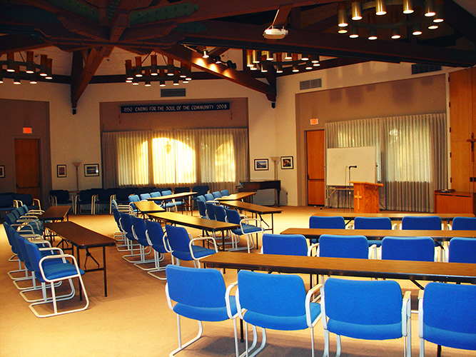
On Nov. 20 – 21 we met at
Christ the King Retreat Center
in Sacramento
to discern
the possibility
of working together
and decided…

Slide 12




Slide 13
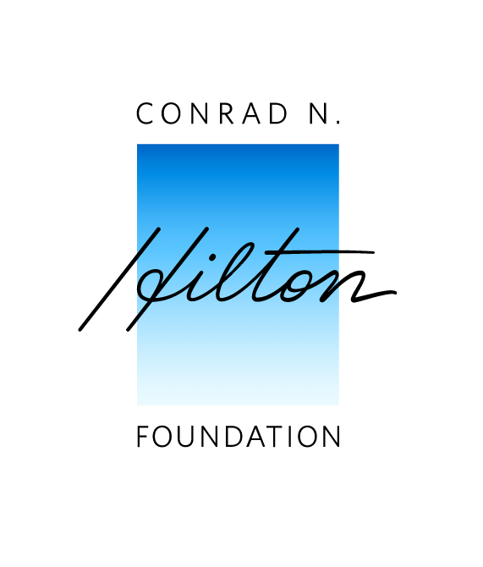
In February
the Conrad Hilton Foundation
awarded CCA a $10,000 grant
for the development of an
on-going formation program
with the MLC

Slide 14

Thanks be to God for this gift of the Spirit!
Now it is time for you to hear from the MLC, about this proposed initiative; its promise and potential for CCA.
“Thanks be to God, who in Christ…and through us
spreads and makes evident the fragrance
of the knowledge of God
everywhere.” 2 Corinthians

